Slide 1
RNA Splicing
Sohan Choudhury

Slide 2
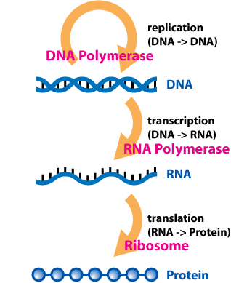
Central Dogma of Molecular Biology
“DNA makes RNA and RNA makes protein”
Replication
DNA copied to DNA
Transcription
DNA copied to mRNA
Translation
Protein synthesis

Slide 3
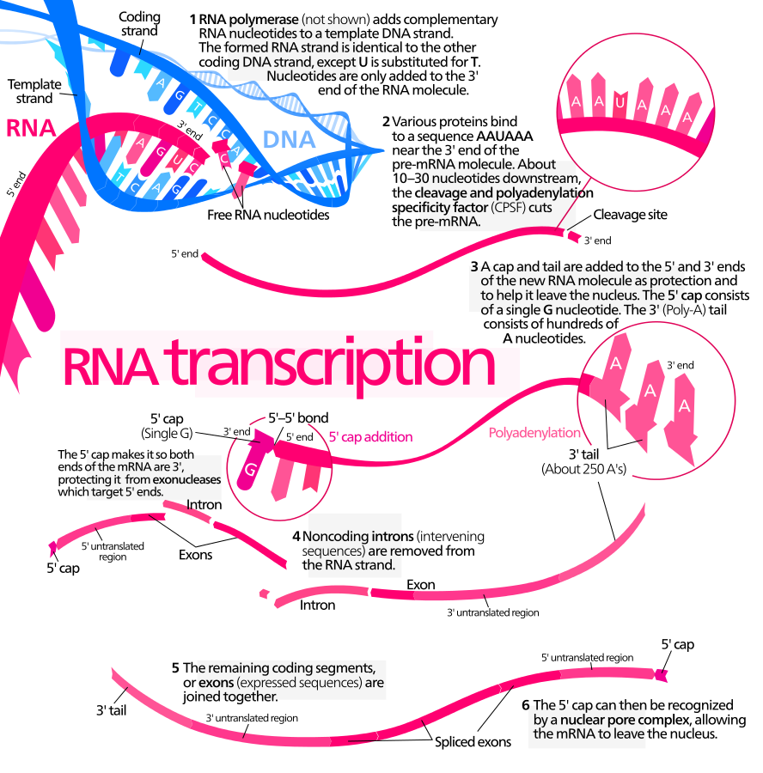
Splicing
Introns (intervening sequences)
Noncoding
Removed from the RNA strand
Exons
Remaining coding segments
Joined together

Slide 4
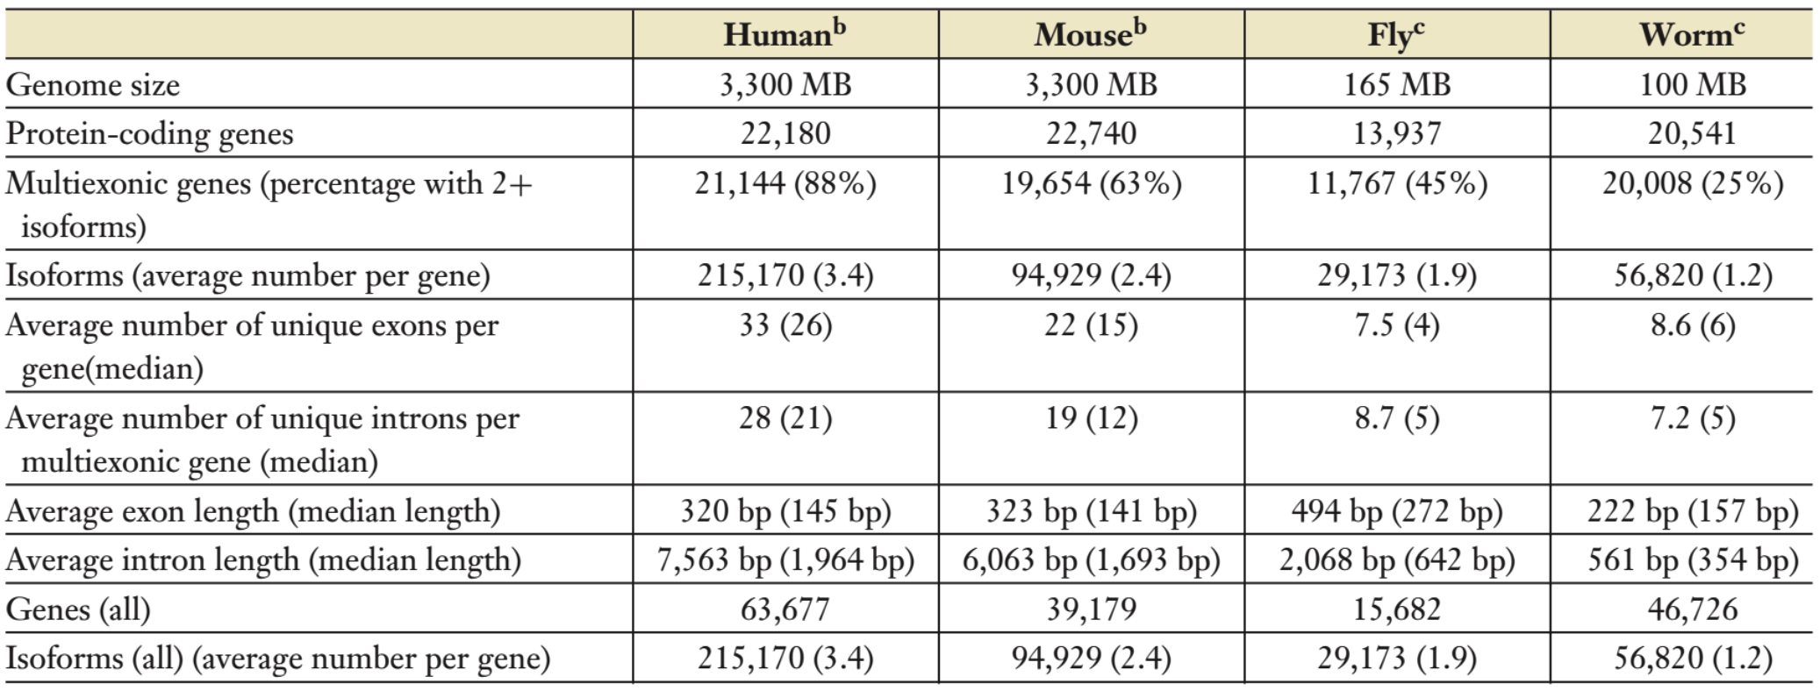
Splicing Basics
Regulated process during gene expression
Results in a single gene coding for multiple proteins

Slide 5
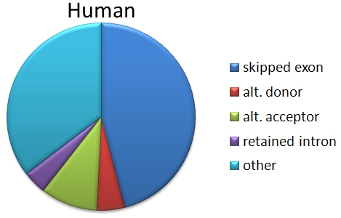
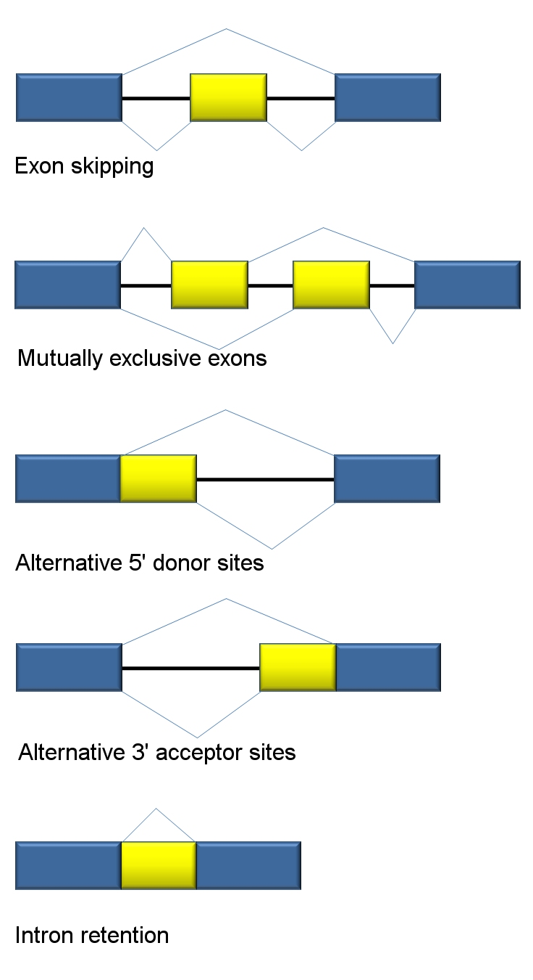
Alternative Splicing

Slide 6
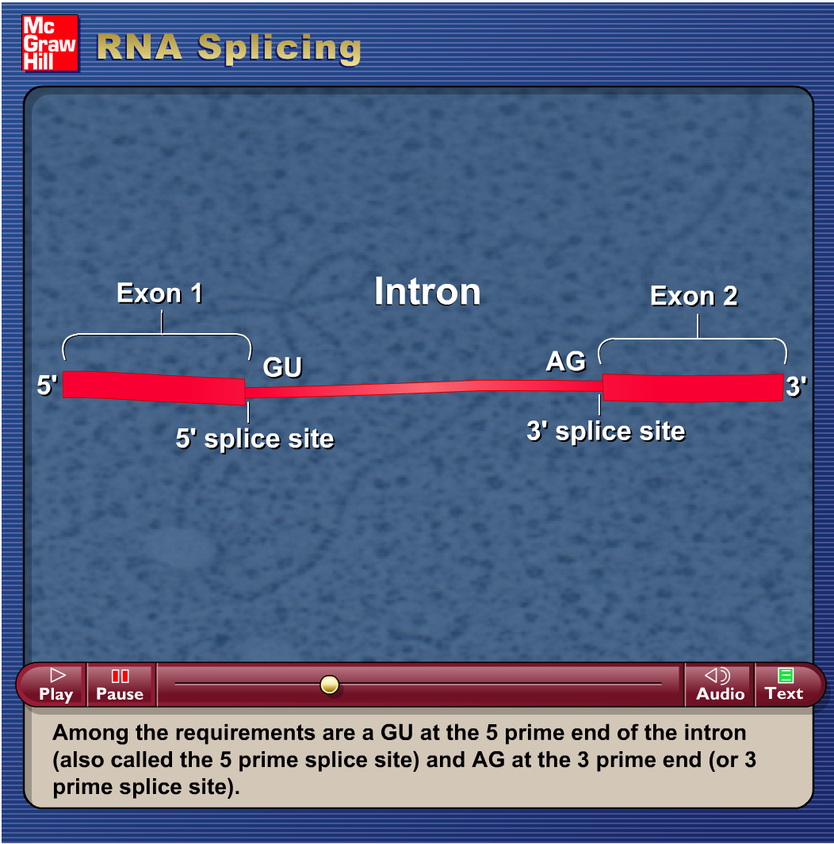
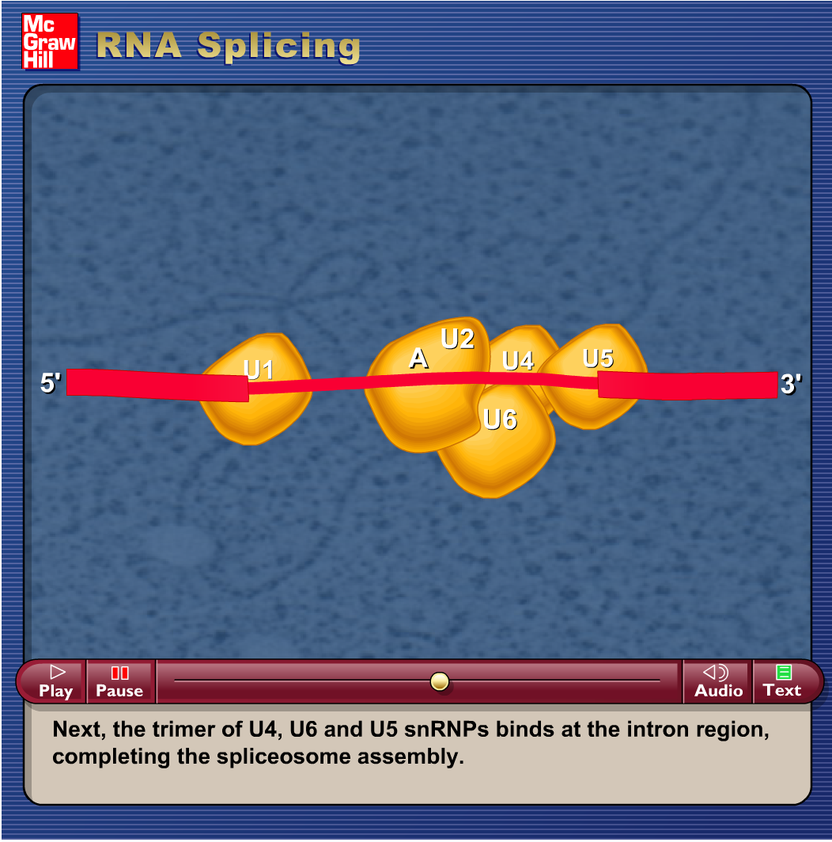
Mechanism

Slide 7
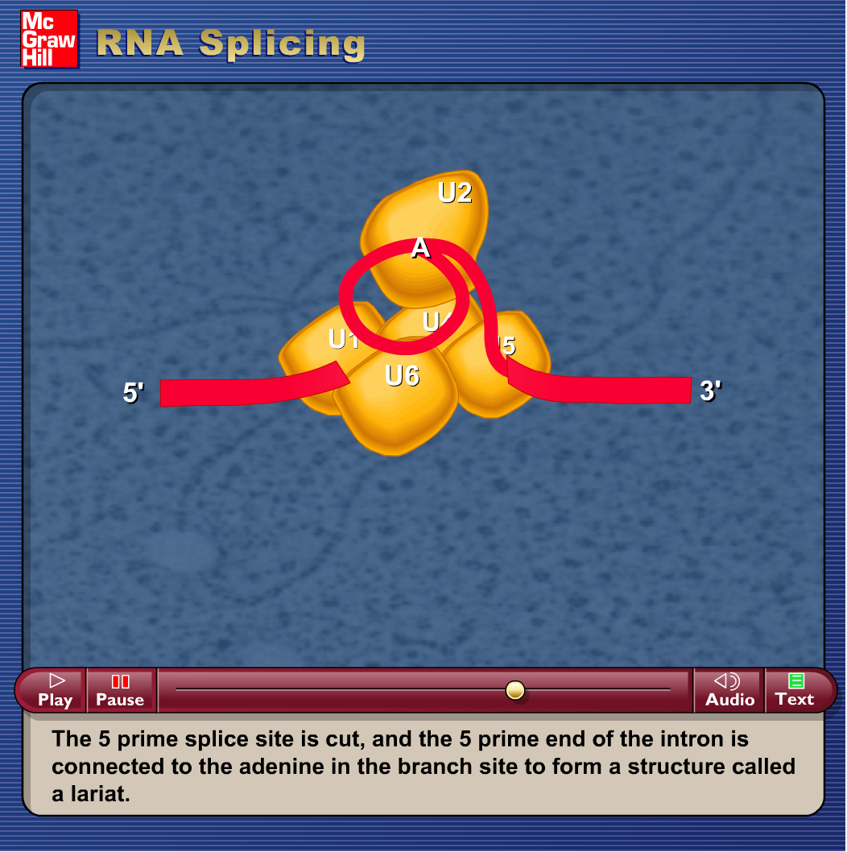
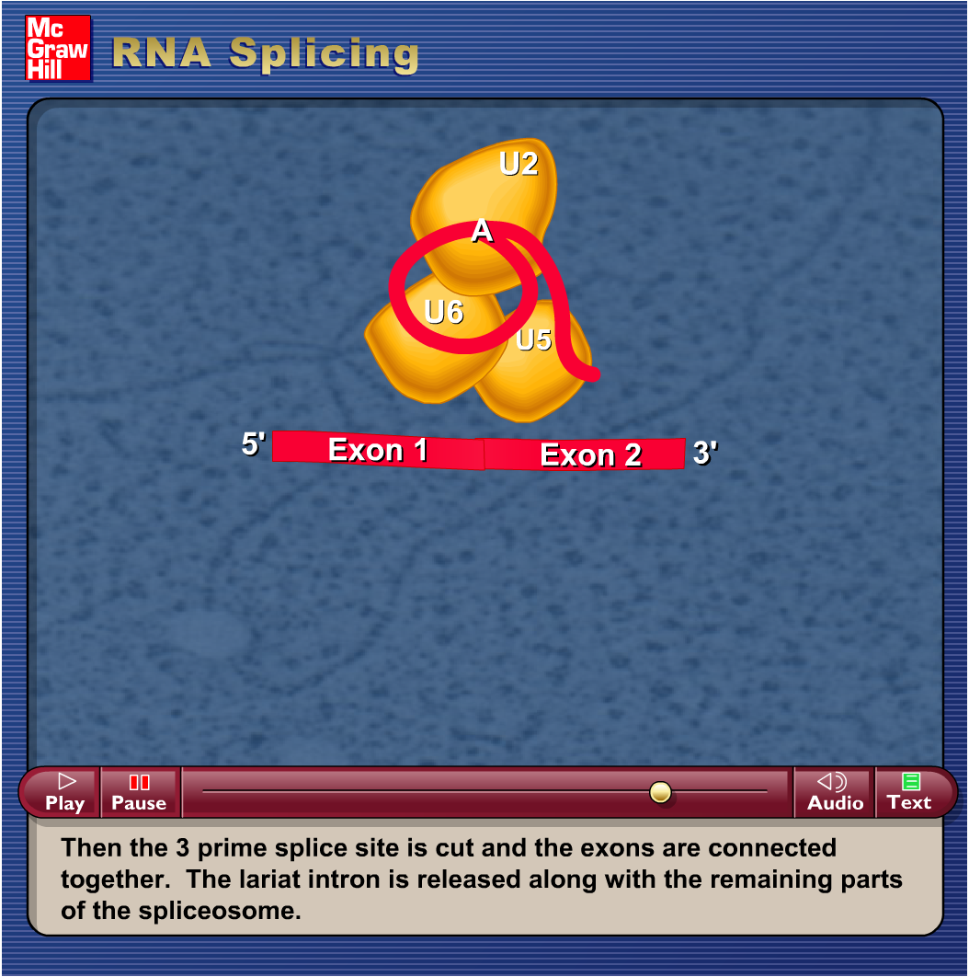
Mechanism (cont.)

Slide 8
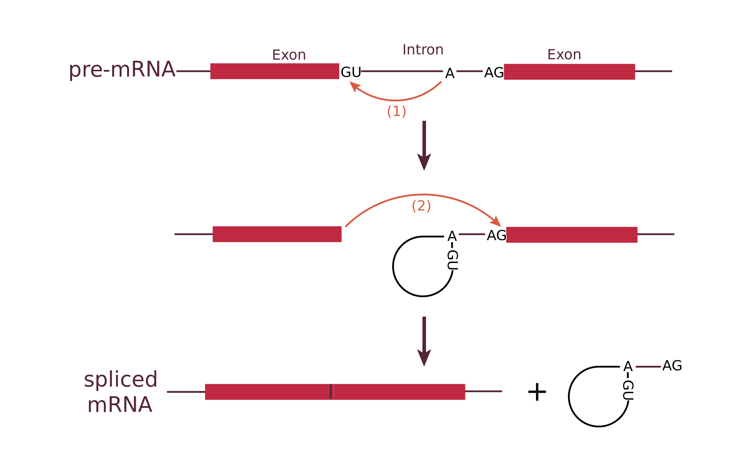
5’ site
3’ site
Lariat

Slide 9
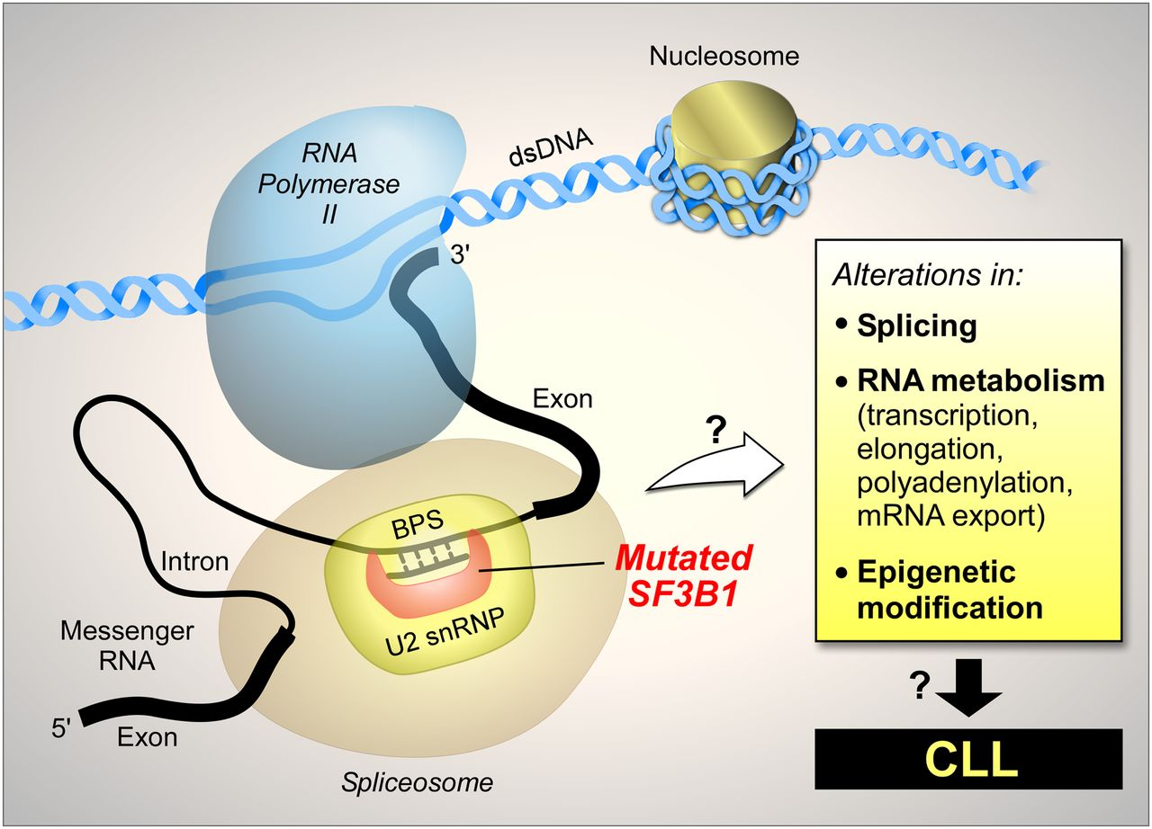
SF3B1
Overexpression of mutant versions could alter splicing patterns
Splicing factors are correlated with at least 2 types of cancer

